Slide 1
Active Contours Without Edges
Group A2
John Charlesworth
Michael Hodgson

Slide 2
Contents
Introduction
Theory
Algorithm
Results
Demo

Slide 3
Introduction
Method for detection of objects within an image
Minimise an energy function
Does not use any edge detection

Slide 4
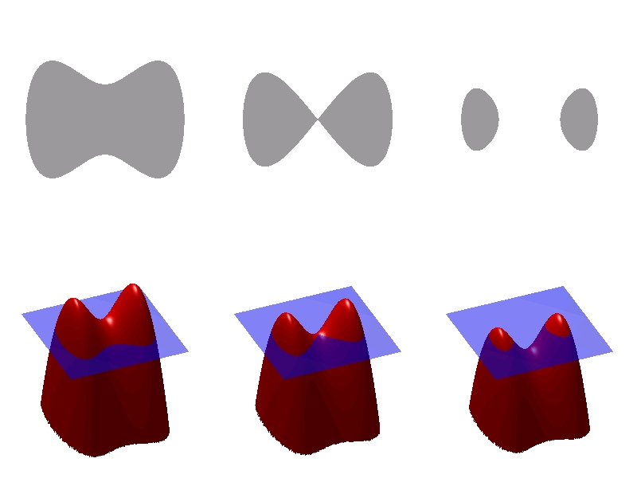
Theory – Level Sets
Parameterising shapes is difficult
Particularly difficult if they change with time
Level sets allow you to model a shape without parameterising it
Zero level is the contour being evolved
http://en.wikipedia.org/wiki/File:Level_set_method.jpg
ɸ - the level set function

Slide 5
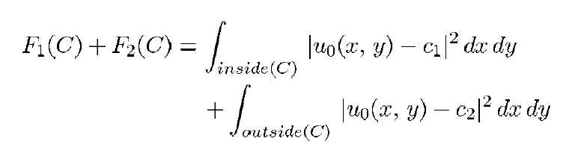
Theory – Minimising the Energy
The curve evolves based on its internal and external forces
When these forces are minimised you are at the shape boundary

Slide 6
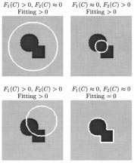
Theory – Minimising the Energy
c1 is the average inside the curve
c2 is the average outside the curve
Forces are attractive

Slide 7
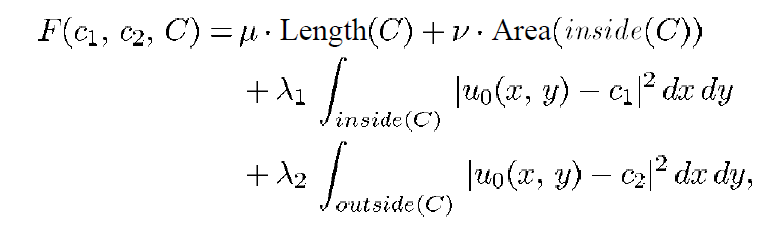
Theory – Constraining the Behaviour

Slide 8
Algorithm
Want to minimize energy
Iterative gradient descent
X

Slide 9
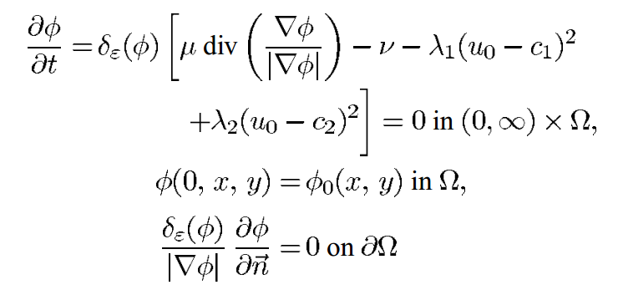
Algorithm
Gradient given by:

Slide 10
Algorithm
Gradient given by:
Curvature of level-set function
Biases contour towards surrounding larger objects rather than lots of small ones

Slide 11
Algorithm
Gradient given by:
So larger μ means larger objects (or groupings of objects) are selected and smaller points are rejected – useful for countering noise
μ set to 1.0 by default in our implementation, but varies throughout our experiments

Slide 12
Algorithm
Gradient given by:
Correction term which pushes the contour towards an object even when curvature is zero or negative
v is set to zero in our implementation

Slide 13
Algorithm
Gradient given by:
Functions of the mean values of the image inside the contour (c₁) and outside the contour (c₂)
λ₁ = λ₂ = 1 in our implementation

Slide 14
Results

Slide 15
Results
NB: We cheated - Re-implemented existing Matlab code in Python

Slide 16
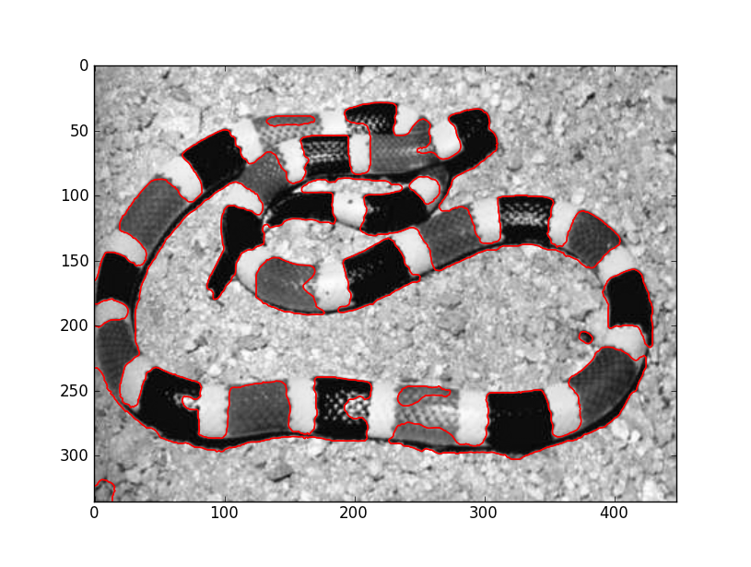
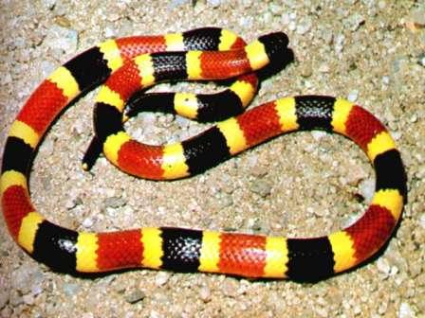
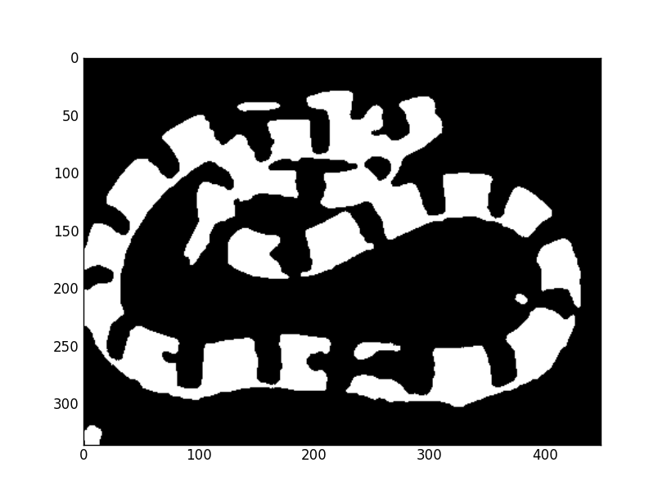
Results
50 iterations, μ = 50000

Slide 17

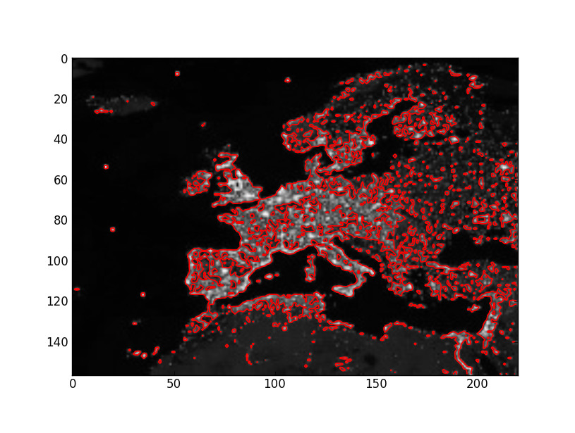
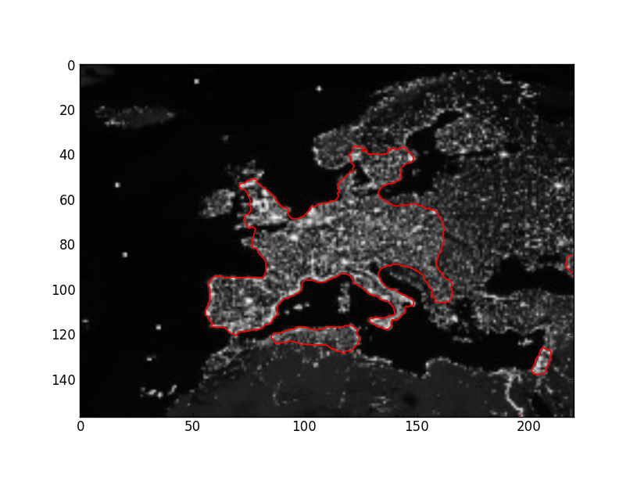
Results – Changing μ
100 iterations, μ = 1
100 iterations, μ = 15000

Slide 18
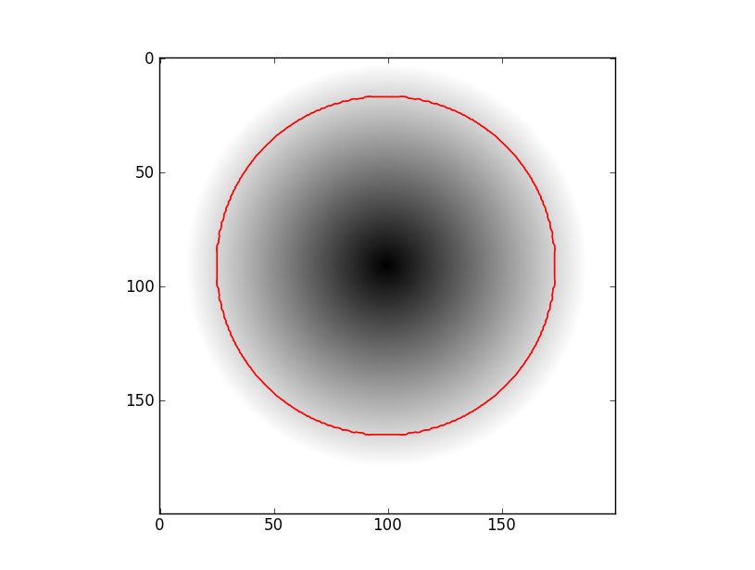

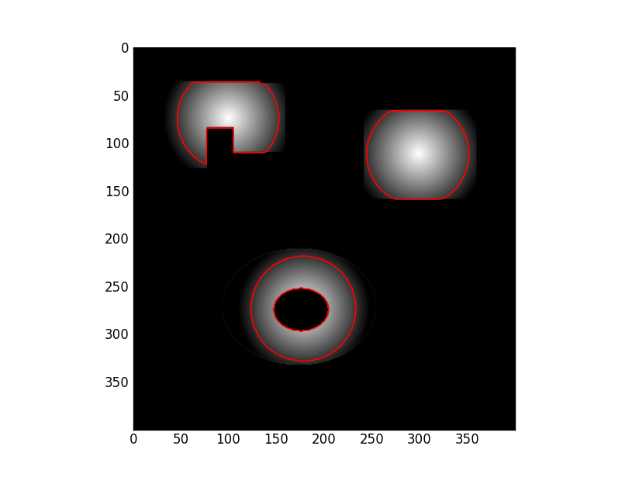
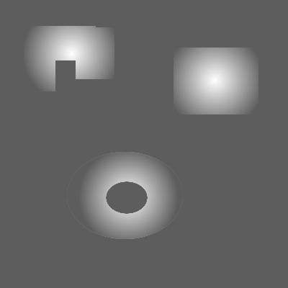
Results – Gradients
5 iterations, μ = 1

Slide 19
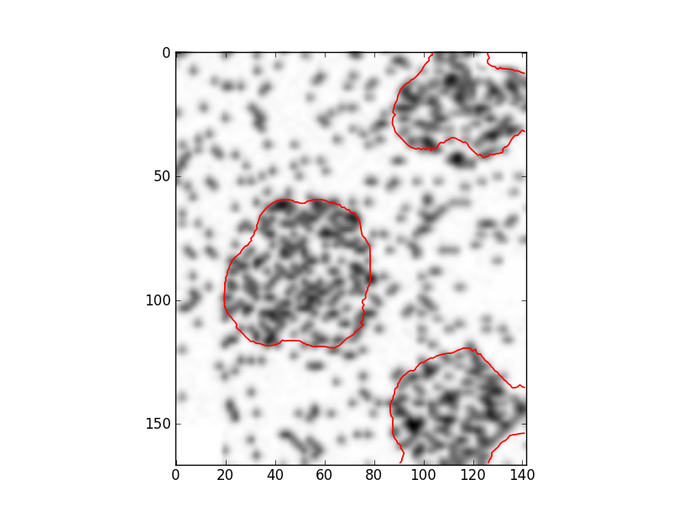
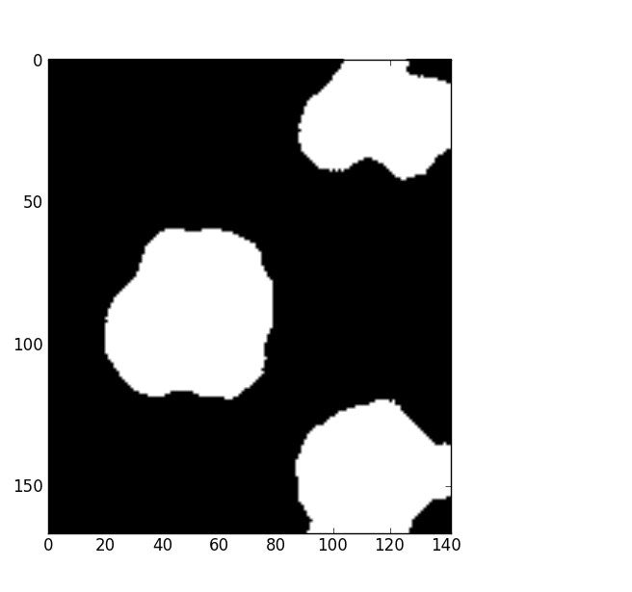
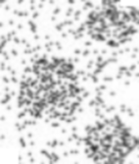
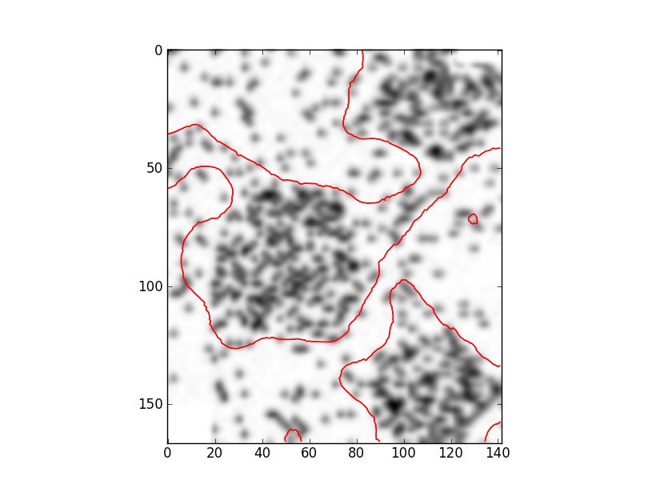
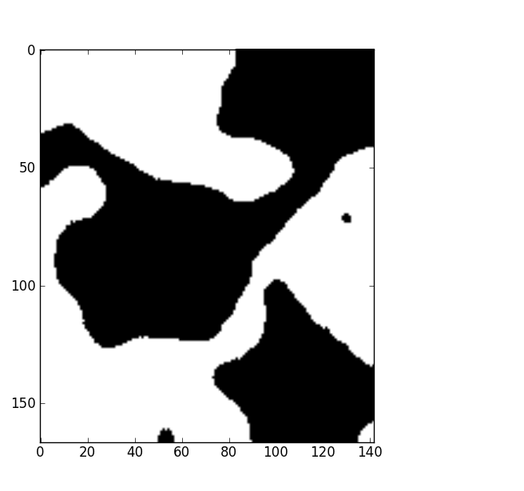
Results – Initial Level Set Functions
100 iterations, μ = 50000

Slide 20
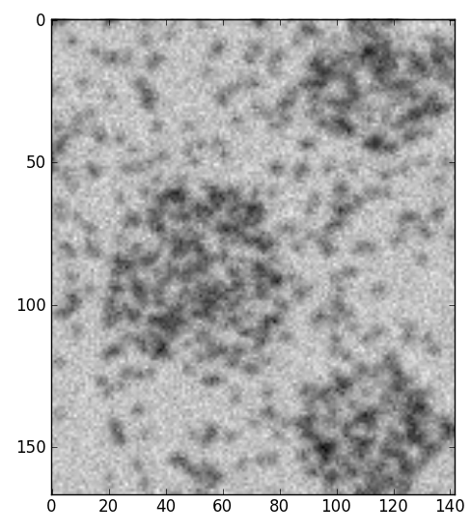
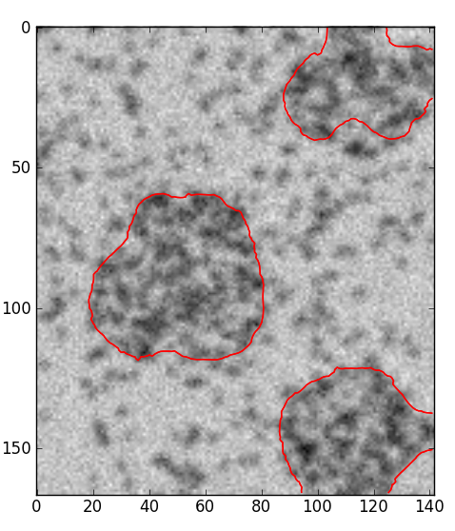
Results – Noise
100 iterations, μ = 50000
Additive Gaussian noise: mean = 0, std deviation = 20 (approx 0.1% of image mean)

Slide 21
Demo

Slide 22
Summary
Advantages:
Responds well to noise (no noise reduction required)
Extracts groupings of objects well
Objects need not be defined by edges
Exact placement of initial contour not critical
Extracts multiple separate objects with one contour

Slide 23
Summary
Disadvantages:
Computation time
Extracts multiple separate objects with one contour
Good parameters for different situations vary significantly

Slide 24
References
[1] - http://www.mathworks.com/matlabcentral/fileexchange/34548-active-contour-without-edge
[2] - Chan, T.F.; Vese, L.A.; , "Active contours without edges," Image Processing, IEEE Transactions on , vol.10, no.2, pp.266-277, Feb 2001 URL: http://ieeexplore.ieee.org/stamp/stamp.jsp?tp=&arnumber=902291&isnumber=19508
[3] - http://www.mathworks.com/matlabcentral/fileexchange/12711-level-set-for-image-segmentation
[4] - Chunming Li; Chiu-Yen Kao; Gore, J.C.; Zhaohua Ding; , "Minimization of Region-Scalable Fitting Energy for Image Segmentation," Image Processing, IEEE Transactions on , vol.17, no.10, pp.1940-1949, Oct. 2008 URL: http://www.ncbi.nlm.nih.gov/pmc/articles/PMC2720140/
[5] - http://www.mathworks.co.uk/help/techdoc/ref/del2.html

